Slide 1

Team Name:
CHALLENGERS
Team Members:
Arun Poochelvan
Ramadevi Settinapalli
Akhila Tupili
Domain Name : COE
Location : Hyderabad

Slide 2
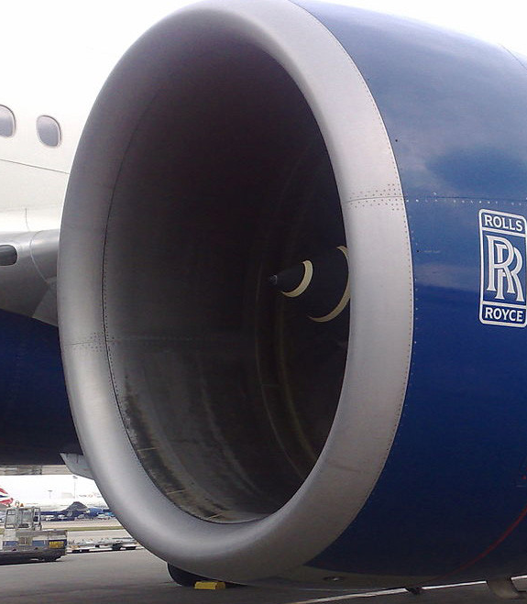
Business Challenge 1: Impact on AirTravel
Turbofan predictive maintenance
The project main theme is to develop a machine learning model to perform predictive maintenance on a Aircraft Turbofan engine.
The project aim is to build a predictive model to estimate the Remaining Useful Life ( RUL) of a jet engine based on run-to-failure data of a fleet of similar jet engines.
Data-set:
NASA has created the Prognostics and Health Management PHM08 Challenge Data Set and is being made publicly available. the data set is used to predict the failures of jet engines over time. The data set was provided by the Prognostics CoE at NASA Ames The data set includes time-series measurements of various pressures, temperatures, and rotating equipment speeds that for the jet engine.
Data set link: https://ti.arc.nasa.gov/tech/dash/groups/pcoe/prognostic-data-repository/#turbofan

Slide 3
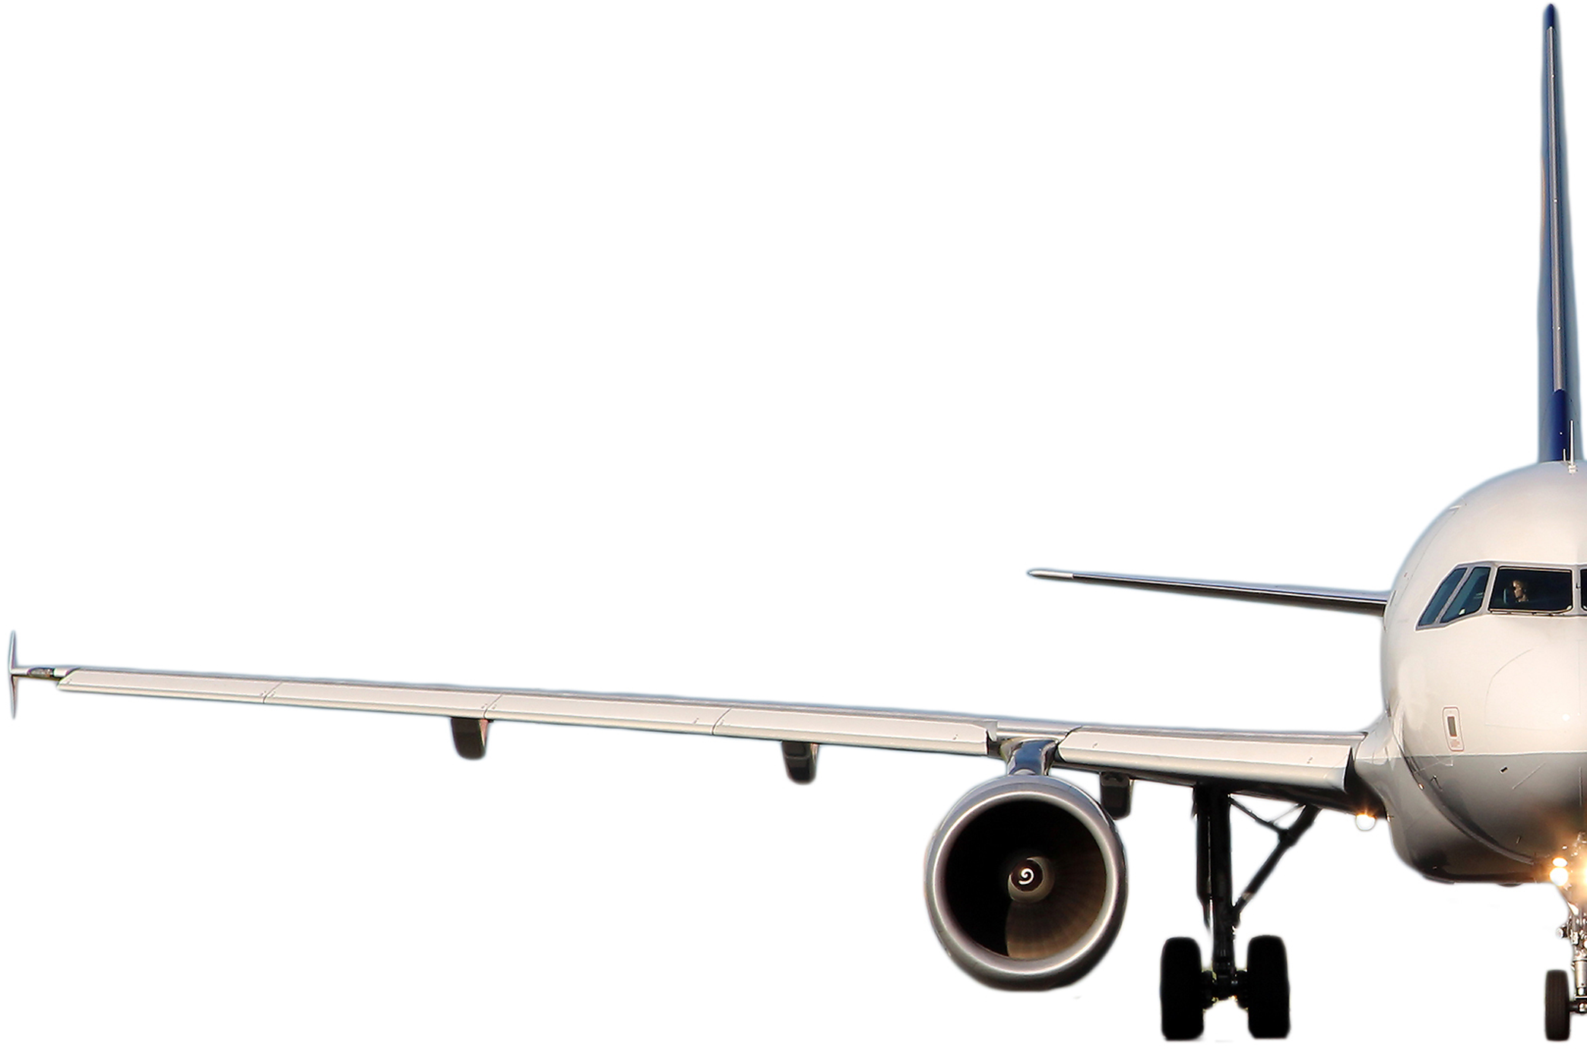




High Level Architecture
Sensor Data
Web APP
Deep learning
Model (LSTM)
Flask API

Slide 4
DATASET
id | cycle | setting1 | setting2 | setting3 | s1 | s2 | s3 | s4 | s5 | s6 | s7 | s8 | s9 | s10 | s11 | s12 | s13 | s14 | s15 | s16 | s17 | s18 | s19 | s20 | s21 | RUL | label1 | label2 | cycle_norm
0 | 1 | 1 | -0.0007 | -0.0004 | 100.0 | 518.67 | 641.82 | 1589.70 | 1400.60 | 14.62 | 21.61 | 554.36 | 2388.06 | 9046.19 | 1.3 | 47.47 | 521.66 | 2388.02 | 8138.62 | 8.4195 | 0.03 | 392 | 2388 | 100.0 | 39.06 | 23.4190 | 191 | 0 | 0 | 1
1 | 1 | 2 | 0.0019 | -0.0003 | 100.0 | 518.67 | 642.15 | 1591.82 | 1403.14 | 14.62 | 21.61 | 553.75 | 2388.04 | 9044.07 | 1.3 | 47.49 | 522.28 | 2388.07 | 8131.49 | 8.4318 | 0.03 | 392 | 2388 | 100.0 | 39.00 | 23.4236 | 190 | 0 | 0 | 2
2 | 1 | 3 | -0.0043 | 0.0003 | 100.0 | 518.67 | 642.35 | 1587.99 | 1404.20 | 14.62 | 21.61 | 554.26 | 2388.08 | 9052.94 | 1.3 | 47.27 | 522.42 | 2388.03 | 8133.23 | 8.4178 | 0.03 | 390 | 2388 | 100.0 | 38.95 | 23.3442 | 189 | 0 | 0 | 3

Slide 5



IBM CLOUD SERVICE
IBM Jupyter Notebook
IBM AUTOAI

Slide 6
Challenges In Building
Finding Dataset
Modelling LSTM Network
Deployment

Slide 7
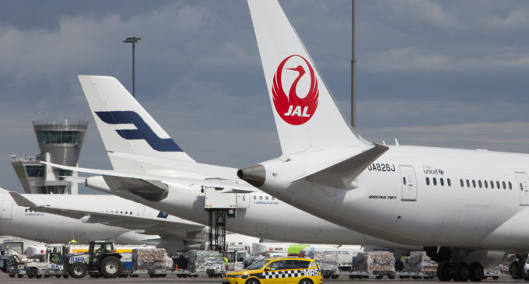
AirTravel Demand
This Project AIMS to predict The Airtravel demand for the Next month.
Dataset Used: The Directorate General of Civil Aviation
Source: http://dgca.nic.in/reports/stat-ind.htm

Slide 8

High Level Architecture
Web APP
Flask API
Time Series Data
Machine learning
Model (Multioutput regressor)

Slide 9
DATASET
YEARS | MONTH | DEPARTURES | FLOWN HOURS | FLOWN KMS | PASSENGERS CARRIED | PASSENGERS KMS.PERFORMED | PASSENGERS AVAILABLE SEATS KMS | PASSENGERS LOAD FACTOR (%) | CARGO FREIGHT | CARGO MAIL | CARGO TOTAL | PAX. TON KMS. PERFORMED | TOTAL TON KMS. PERFORMED | AVAILABLE TON.KMS | WEIGHT LOAD FACTOR (%)
0 | 2001 | 4 | 16846 | 29712 | 17315 | 1417985 | 2101 | 3209 | 66 | 18373 | 1937 | 20310 | 187 | 231 | 375 | 62
1 | 2001 | 5 | 17654 | 31232 | 18213 | 1520055 | 2243 | 3370 | 67 | 20287 | 2150 | 22437 | 199 | 247 | 393 | 63
2 | 2001 | 6 | 17113 | 30464 | 17802 | 1406553 | 2141 | 3293 | 65 | 18992 | 2034 | 21026 | 191 | 235 | 383 | 61
3 | 2001 | 7 | 17592 | 31427 | 18457 | 1418581 | 2192 | 3426 | 64 | 18863 | 2084 | 20947 | 196 | 239 | 399 | 60
4 | 2001 | 8 | 17605 | 31421 | 18549 | 1399146 | 2179 | 3451 | 63 | 18968 | 2065 | 21033 | 196 | 240 | 404 | 59

Slide 10
IBM CLOUD SERVICE
IBM Jupyter Notebook

Slide 11
Challenges In Building
Finding Dataset
Modelling Multiple output regressor in Time series dataset
Deployment

